Slide 1
Chapter 2
Process Models
Slide Set to accompany
Software Engineering: A Practitioner’s Approach, 7/e
by Roger S. Pressman
Slides copyright © 1996, 2001, 2005, 2009 by Roger S. Pressman
For non-profit educational use only
May be reproduced ONLY for student use at the university level when used in conjunction with Software Engineering: A Practitioner's Approach, 7/e. Any other reproduction or use is prohibited without the express written permission of the author.
All copyright information MUST appear if these slides are posted on a website for student use.
SLIDE SET 7

Slide 2
A Layered Technology
Software Engineering
tools
methods
process model
a “quality” focus
These courseware materials are to be used in conjunction with Software Engineering: A Practitioner’s Approach, 6/e and are provided with permission by R.S. Pressman & Associates, Inc., copyright © 1996, 2001, 2005

Slide 3

A Generic Process Model

Slide 4
A Process Framework
Process framework
  Framework activities
    work tasks
    work products
    milestones & deliverables
    QA checkpoints
  Umbrella Activities
These courseware materials are to be used in conjunction with Software Engineering: A Practitioner’s Approach, 6/e and are provided with permission by R.S. Pressman & Associates, Inc., copyright © 1996, 2001, 2005

Slide 5
Framework Activities
Communication
Planning
Modeling
  Analysis of requirements
  Design
Construction
  Code generation
  Testing
Deployment
These courseware materials are to be used in conjunction with Software Engineering: A Practitioner’s Approach, 6/e and are provided with permission by R.S. Pressman & Associates, Inc., copyright © 1996, 2001, 2005

Slide 6
Umbrella Activities
Software project management
Formal technical reviews
Software quality assurance
Software configuration management
Work product preparation and production
Reusability management
Measurement
Risk management
These courseware materials are to be used in conjunction with Software Engineering: A Practitioner’s Approach, 6/e and are provided with permission by R.S. Pressman & Associates, Inc., copyright © 1996, 2001, 2005

Slide 7

Process Flow

Slide 8
Identifying a Task Set
A task set defines the actual work to be done to accomplish the objectives of a software engineering action.
  A list of the task to be accomplished
  A list of the work products to be produced
  A list of the quality assurance filters to be applied

Slide 9
Process Assessment and Improvement
Standard CMMI Assessment Method for Process Improvement (SCAMPI) — provides a five step process assessment model that incorporates five phases: initiating, diagnosing, establishing, acting and learning.
CMM-Based Appraisal for Internal Process Improvement (CBA IPI)—provides a diagnostic technique for assessing the relative maturity of a software organization; uses the SEI CMM as the basis for the assessment [Dun01]
SPICE—The SPICE (ISO/IEC15504) standard defines a set of requirements for software process assessment. The intent of the standard is to assist organizations in developing an objective evaluation of the efficacy of any defined software process. [ISO08]
ISO 9001:2000 for Software—a generic standard that applies to any organization that wants to improve the overall quality of the products, systems, or services that it provides. Therefore, the standard is directly applicable to software organizations and companies. [Ant06]

Slide 10
Software life cycle
Series of identifiable stages that a software product undergoes during its life time:
    Feasibility study
    Requirements analysis and specification,
    Design,
    Coding,
    Testing
    maintenance.

Slide 11
Software Life Cycle
  identifies all the activities required for product development,
  establishes a precedence ordering among the different activities,
  Divides life cycle into phases.

Slide 12
Life Cycle Model is Adhered to,
  the project manager can at any time fairly accurately tell,
    at which stage (e.g., design, code, test, etc. ) of the project is.
  Otherwise, it becomes very difficult to track the progress of the project
    the project manager would have to depend on the guesses of the team members.

Slide 13
Attention to Specific models
  Classical waterfall model
  Iterative waterfall,
  Evolutionary,
  Prototyping, and
  Spiral model

Slide 14
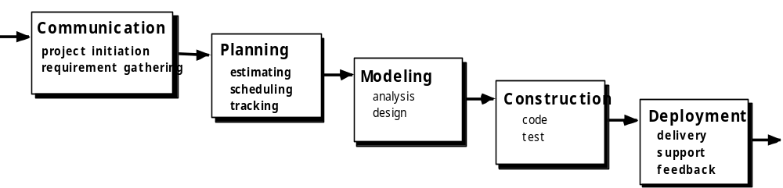
The Waterfall Model

Slide 15

The V-Model

Slide 16
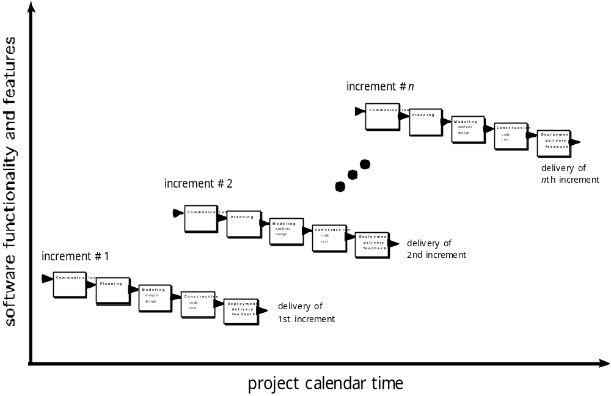
The Incremental Model

Slide 17
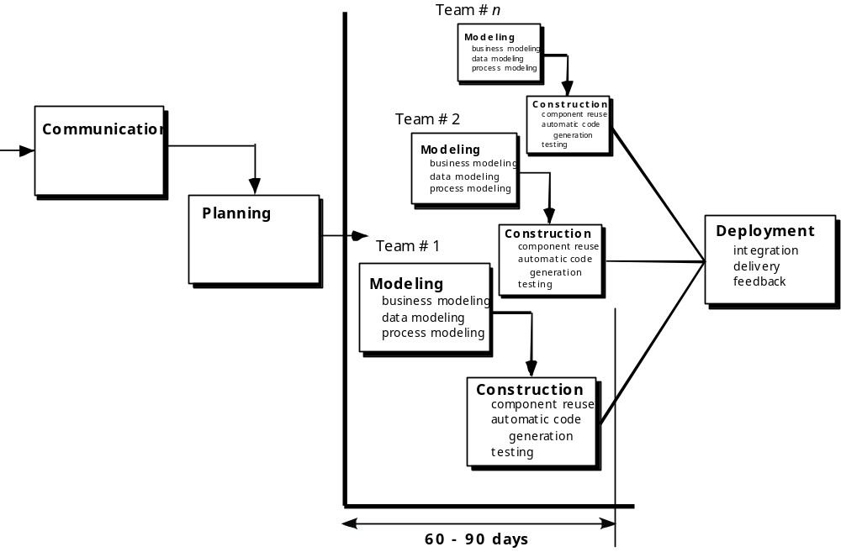
The RAD Model

Slide 18

Evolutionary Models: Prototyping
Quick
plan
communication
Modeling
Quick design
Deployment
delivery &
feedback
Construction
of prototype
Construction
of prototype

Slide 19
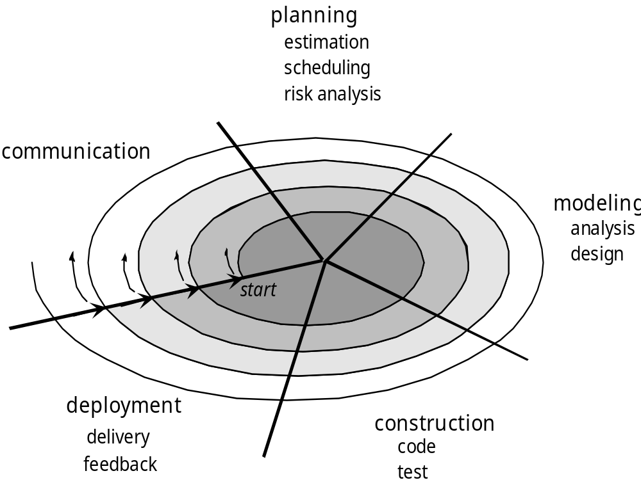
Evolutionary Models: The Spiral

Slide 20
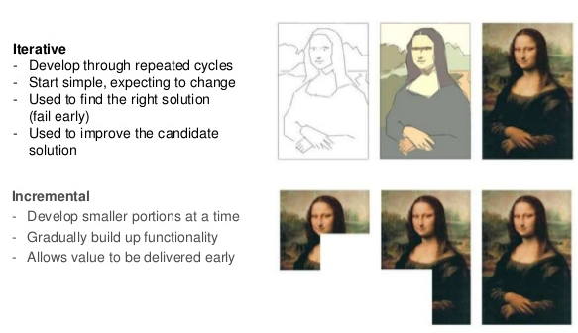
Iterative vs Incremental Model
Source: Scrum Guide 6; 7 at slideshare.net

Slide 21
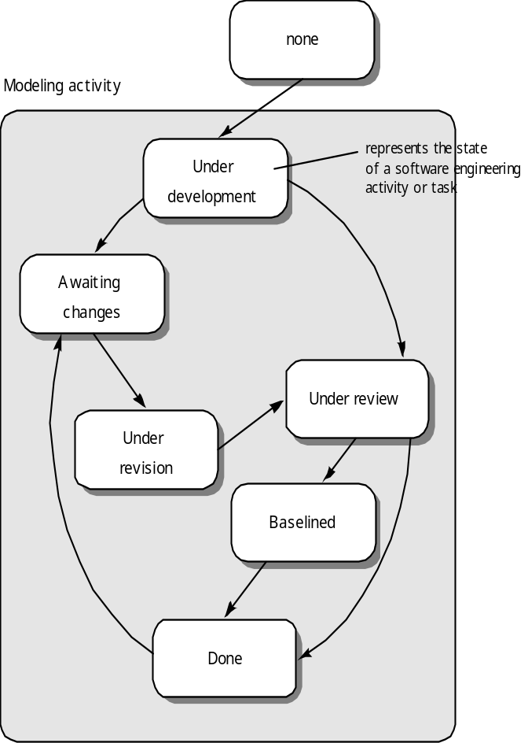
Evolutionary Models: Concurrent

Slide 22
Still Other Process Models
Component based development—the process to apply when reuse is a development objective
Formal methods—emphasizes the mathematical specification of requirements
AOSD—provides a process and methodological approach for defining, specifying, designing, and constructing aspects
Unified Process—a “use-case driven, architecture-centric, iterative and incremental” software process closely aligned with the Unified Modeling Language (UML)

Slide 23

The Unified Process (UP)
elaboration
inception

Slide 24
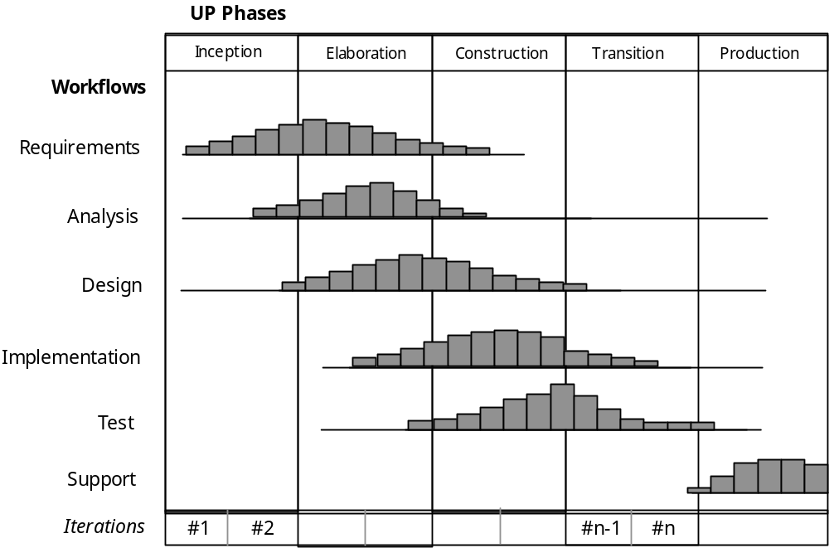
UP Phases

Slide 25
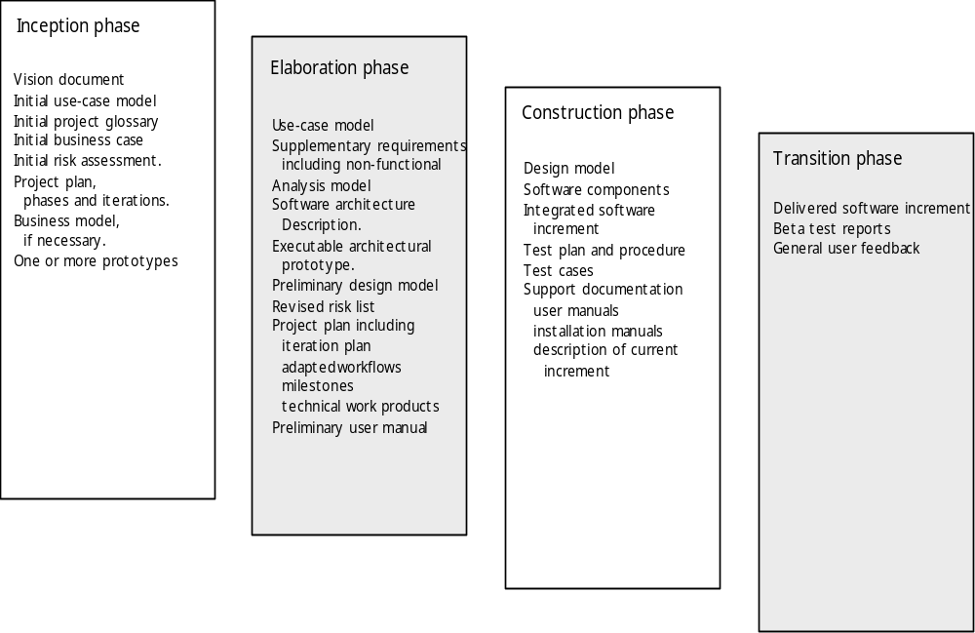
UP Work Products

Slide 26
Agile
https://www.youtube.com/watch?v=yagk8a5w_4U
Scrum
https://www.youtube.com/watch?v=WxiuE-1ujCM

Slide 27
Video Links
Waterfall Model
https://www.youtube.com/watch?v=Y_A0E1ToC_I
Prototyping Model
https://www.youtube.com/watch?v=dlxxXF0wrdc
https://www.youtube.com/watch?v=v8WzC5bCqY0
Spiral Model
https://www.youtube.com/watch?v=6gMgXP1Sa9I

